Slide 1

Overview of Store-and-Forward Packet Switching

Slide 2

Datagram Subnet Operation
Given that process P1 on H1 has a long message for P2 on H2
  Assume that message is 4 times longer than maximum packet size (4 packets-1, 2, 3, 4)
Routing within a diagram subnet.

Slide 3

Comparison of Virtual-Circuit and Datagram Subnets

Slide 4
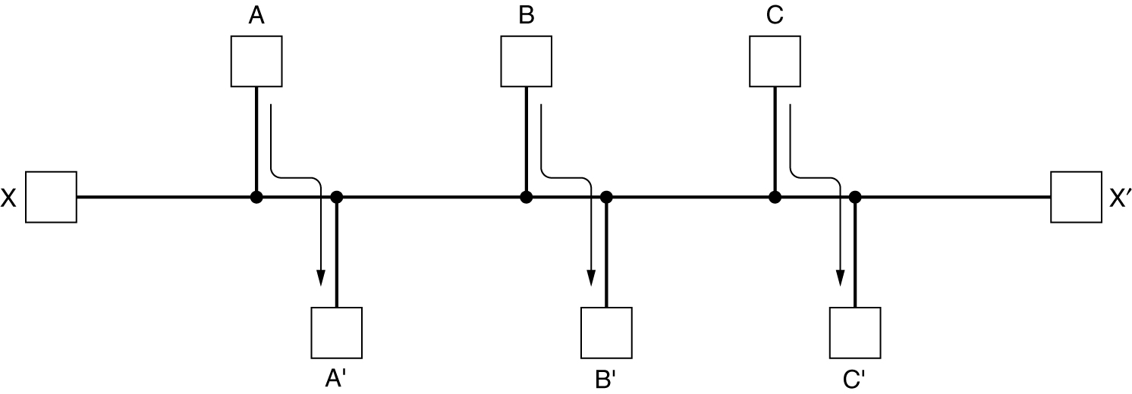
Routing Algorithm Desirable Properties

Slide 5
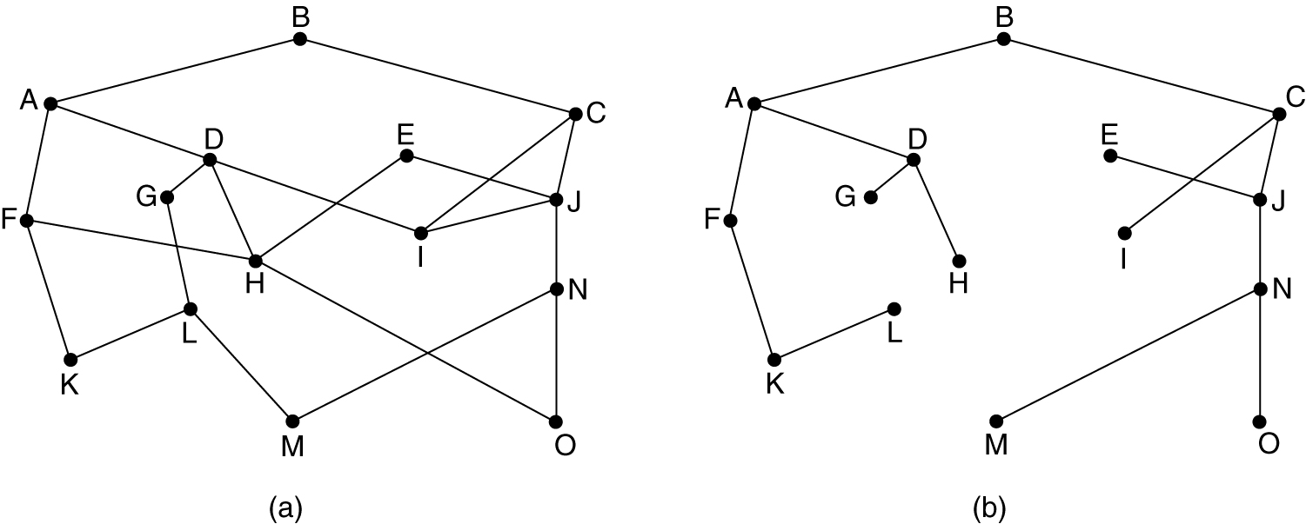
The Optimality Principle
(a) A subnet. (b) A sink tree for router B.

Slide 6
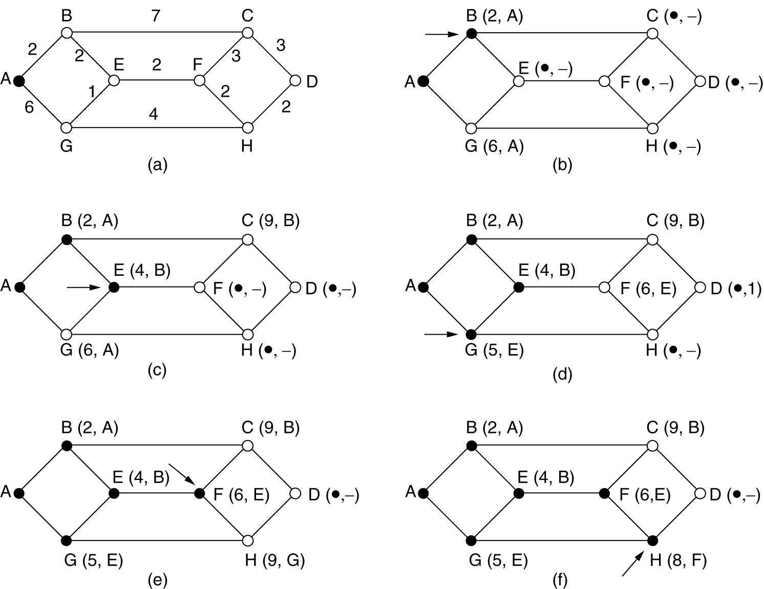
Shortest Path Routing
First 5 steps used in computing the shortest path from A to D
  Arrows indicate the working node
  (x,y) at each node represents x distance and y as previous node

Slide 7
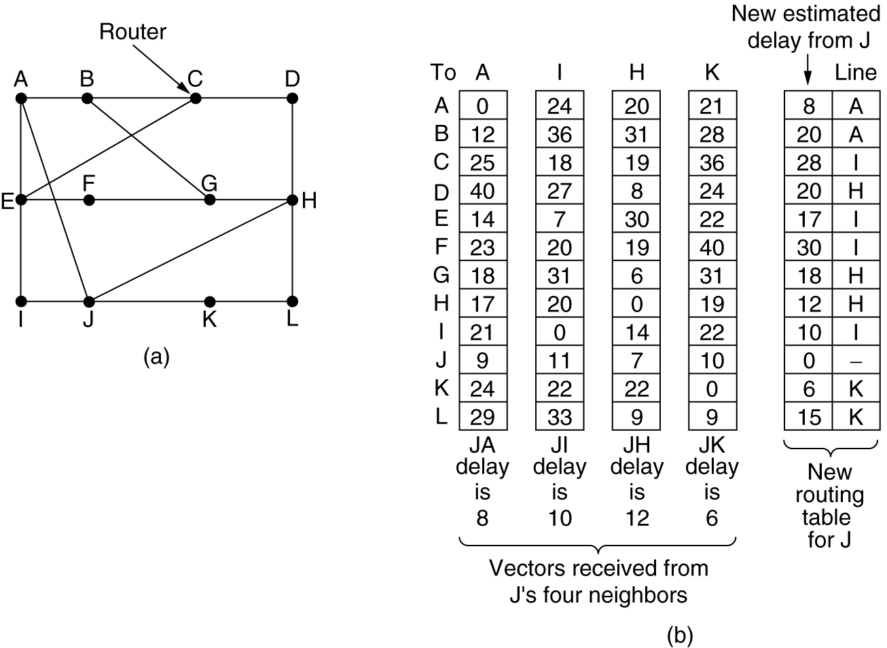
Distance Vector Routing
(a) A subnet. (b) Input from A, I, H, K, and the new
routing table for J.

